Slide 1
Youth Suicide and Risk
Dana Duval, LICSW
Kaitlin Richotte-Rock, LMHC
Notes:
Possible youtube video: https://www.youtube.com/watch?v=uOlfHs79G1I&rco=1 or this video even credits teen CIT! https://www.youtube.com/watch?v=iKzU1yCo0I0

Slide 2
Language & Stigma
In no other instances of death do we place the blame on the person, except when they die by suicide.
What are other things do we “commit”?
Adultery
Sin
A Felony
AN INDIVIDUAL DIED BY SUICIDE

Slide 3
Preferred Language
•Suicidal thoughts → Suicidal Intensity
•Committed, Completed→ died by suicide
•Serious → level of lethality
•Attention seeking→Attention needing
Client First Language
What are some examples?

Slide 4
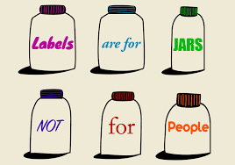
Examples of Client-First Language
Terms to Avoid | Suggested Term
Victim | Person who has been impacted by
Mentally Ill Person | Person living with…
Addict | Person with a Substance Use Disorder/ Person Using Substance
Homeless Person | Person without Housing
Prostitute | Person who engages in sex work
Prisoner/Convict | Person who is/has been incarcerated

Slide 5
Youth Suicide Rates
Suicide rates among youth ages 10-24 increased 62% from 2007-2021, from 6.8 t0 11.0 per 100,00. (CDC.gov)

Slide 6
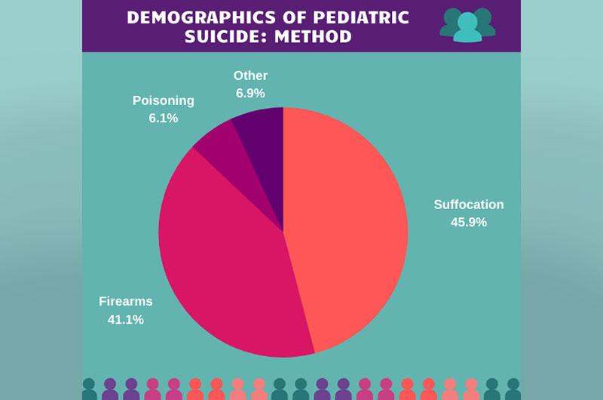

Slide 7
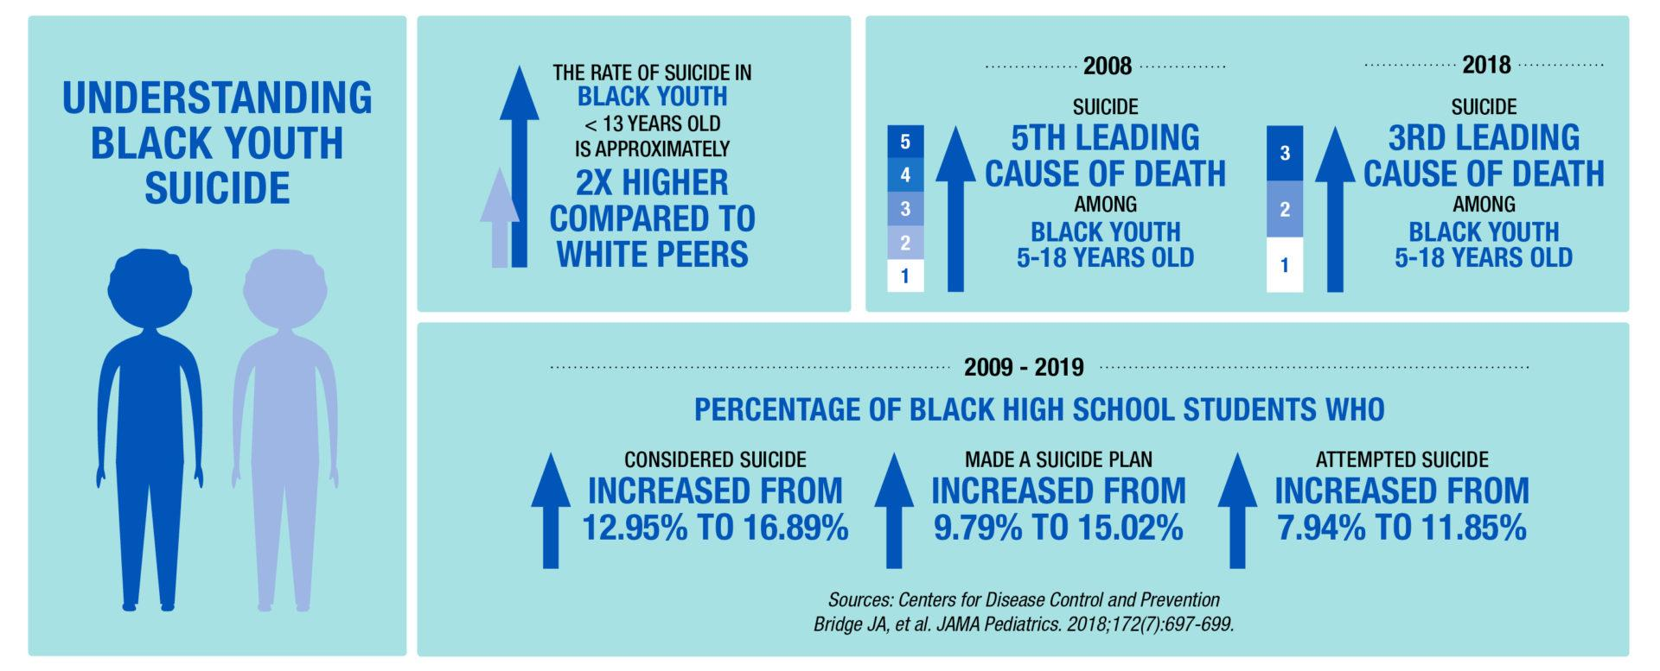

Slide 8
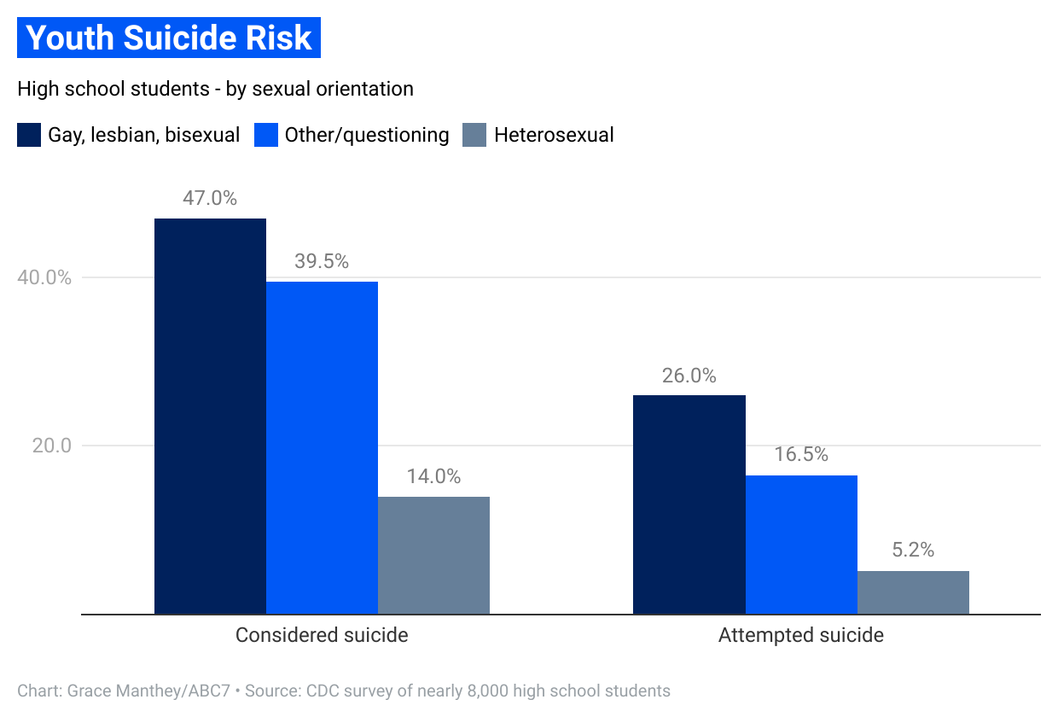

Slide 9
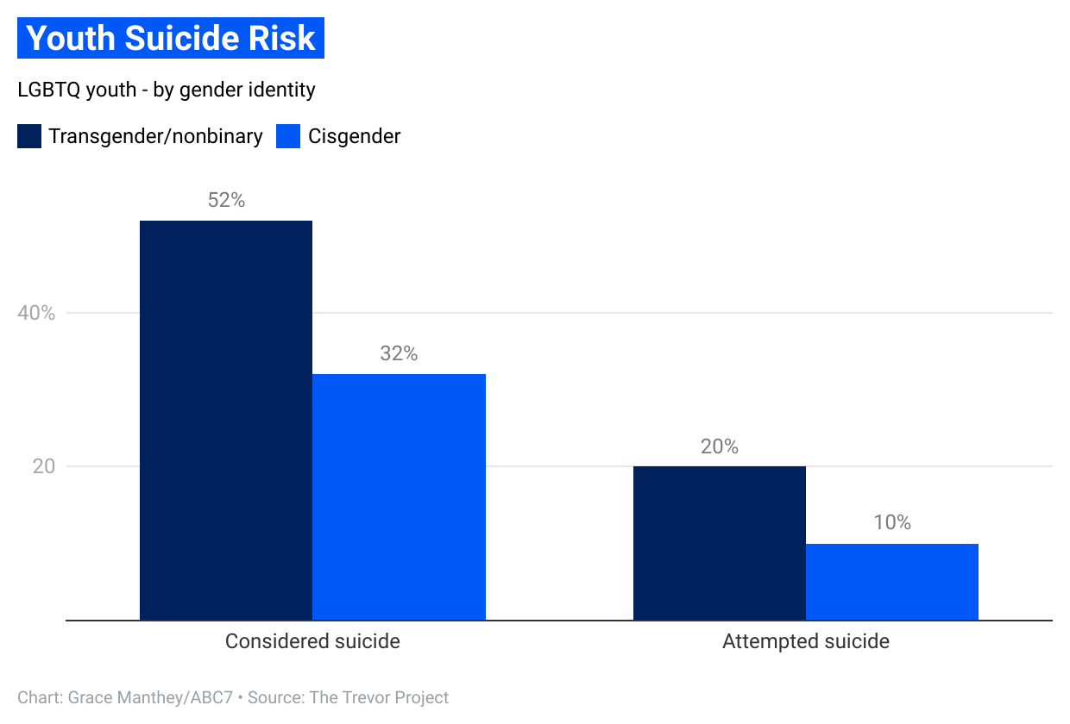

Slide 10
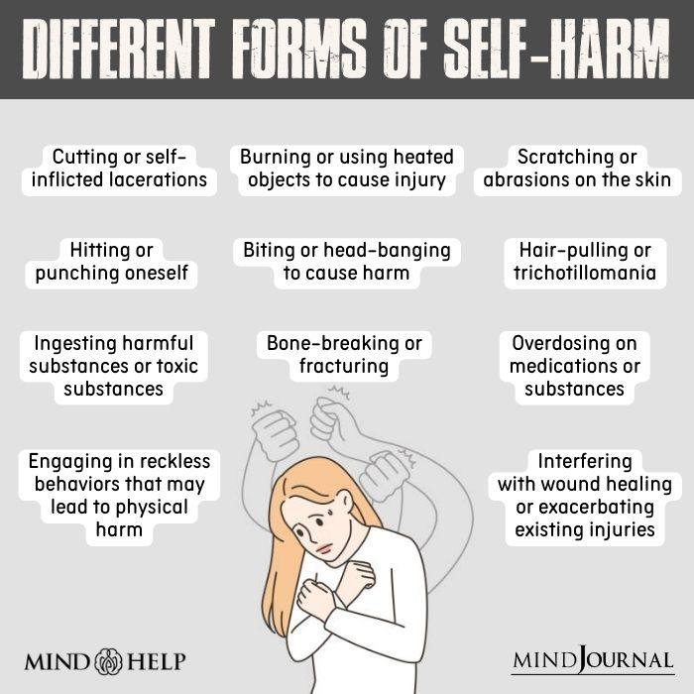
When you’re called to a self-harming call, what could you expect to see?

Slide 11
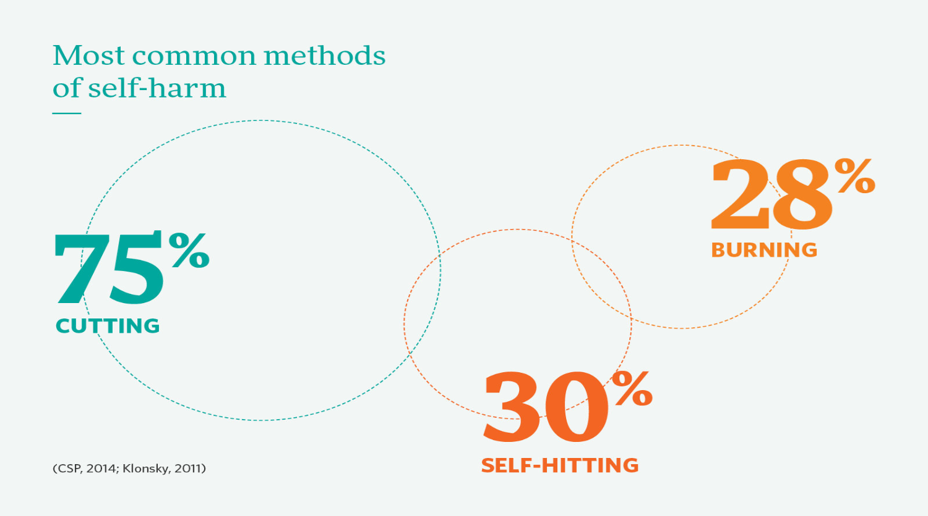

Slide 12
Why Do People Self Harm?
Possible reasons for self harm:
●To reduce negative emotions
●To feel “something”
●To over come suicidal thoughts
●To avoid certain situations/emotions
●To access social supports
Self-harm can be a sign of suicidal ideation, but it is not always a high risk behavior.

Slide 15
Myths VS. Facts about Self-Harm
Talking about self-harm will make the situation worse.
Only teenagers engage in self-harm.
Self-harming behavior is a phase that individuals will outgrow.
Self-harm is a result of bad parenting or neglect.
Self-harm is always a sign of mental illness.
Self-harm is attention-seeking behavior.
Self-harm is often a coping mechanism for emotional pain or distress.
People of various ages can engage in self-harm, including adults and the elderly.
Self-harm is not neccesarily an indicator of suicidal intent.
Self-harm is a relapsing, life-long mental health condition.
Self-harm can be influenced by a complex interplay of individual factors, such as genetics, environment, and mental health.
Self-harm can also result from temporary stressors and not solely from mental illness.
Compassionate and non-judgemental discussion about self-harm, therapy, and medication can help individuals recover from self-harm.

Slide 16
Suicide compared to other risk

Slide 17
Individual Risk Factors
Current or Prior History of Adverse Childhood Experiences (ACES)
History of depression and other mental illness
Serious physical illness (sleep disorders)
Impulsive or aggressive tendencies
Substance Use
Violence Victimization and/or perpetration
LGBTQ, gender-nonconforming
Past suicidal ideation and/or suicide attempts
Pathological computer use

Slide 19
Relational Risk Factors
Being Bullied and/or Bullying Others
Parental Mental illness, suicide attempts
Other relationship losses
Living in residential facility
Adoption and/or foster care
Poor parental-child relationships
Low social support when identifying as LGBTQ
Firearm accessibility in the home
Intergenerational Trauma

Slide 20
Community Risk Factors
Social Isolation
High economic distress
Rural areas
Social exposures to suicides in school, community
High firearm ownership
Weak firearm safety laws
Discrimination
Lack of access to mental health treatment
Community violence
Historical Trauma

Slide 21
Societal Risk Factors
Stigma associated with help-seeking and mental illness
Stigma around LGBTQ/gender nonconforming individuals
Racism
Easy access to leath means of suicide among people at risk
Unsafe media portrayals of suicide

Slide 22
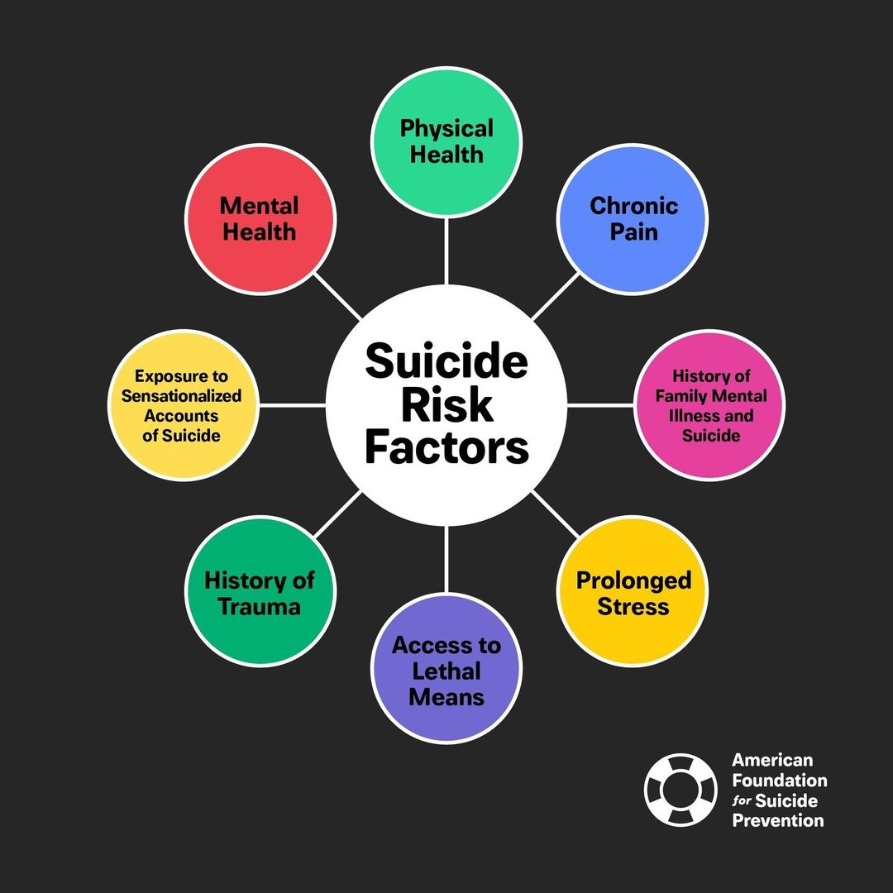

Slide 23
Individual Protective Factors
Attitudes, values, and norms prohibiting suicide
Effective Coping and Problem-Solving Skills
Reasons for Living (family, friends, pets, future goals, etc)
Good health
Optimism, hope for the future
Impulse Control
Strong sense of self-worth
Sense of self-determination
Engagement in extracurriculars and/or personal interests/activities
Strong sense of cultural identity
Religion

Slide 24
Relational Protective Factors
Strong relationships, particularly with family members
Acceptance of one’s identity by their family/peers
A sense of responsibility and connection to others
Pets
Family involvement in one’s mental health treatment
Family commitment to restricted access to lethal means (i.e. safe gun storage)

Slide 25
Community Protective Factors
Availability of consistent and high quality physical and mental health care
Feeling connected to school, community, and other social institutions.
One’s identity being accepted by one’s larger community

Slide 26
Societal Protective Factors
Reduced access to lethal means of sucide among people at risk
Cultural shifts in acceptance of mental health as part of life and decreasing stigma around individuals seeking treatment
Cultural shifts in acceptance for individuals with typically “othered” identities
LGBTQ/gender nonconforming
BIPOC communities
Neurodiverse communities

Slide 27
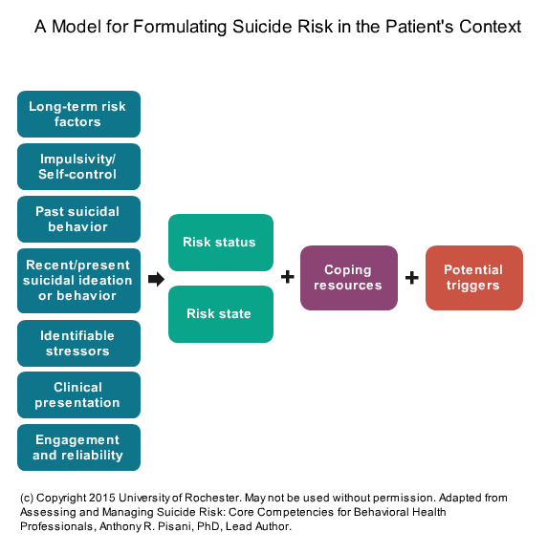
Notes:
This might be irrelevant or maybe is a good slide to transition talking from talking about suicide/information about suicide (the blue boxes on the left) to working with suicidal folks (green/purple/red box). Might also be a better graphic for a clinical presentation than CIT

Slide 28
Suicidal ideation, plan, intent & means
Asking about suicide does not increase an individuals suicidal risk, in fact, research has shown this to not be true and, has shown that asking someone if they are having thoughts of killing themselves is actually more likely to save a life.

Slide 29
Be Direct When Asking About Suicide
Common Ways to Ask About Suicide:
Have you thought about hurting yourself?
Are you feeling safe?
INSTEAD, ASK DIRECT QUESTIONS:
Are you thinking about suicide?
Do you have a plan? (specific)
Do you have a time frame?
Do you have the means?

Slide 30
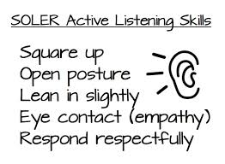
Active Listening
3 R’s of Active Listening
●Repeat
●Reflect
●Respond

Slide 31
Active Listening
Tips
Face speaker/eye contact
Look for non-verbal communication
Do not interrupt
Listen without jumping to conclusions
Do not start planning what to say next
Listen with an uncluttered mind
Show that you are listening
Ask questions
Paraphrase and summarize

Slide 32
Assessing for Risk
Pay attention for Risk and Protective Factors in the environment and report
Ask Direct Questions regarding concerns of safety risks and listen to the response
Pay attention to the differences between Ideation and Intent
Talk with the youth and their family to ensure you’re getting a full understanding of the situation
Bring in additional resources when necessary

Slide 33
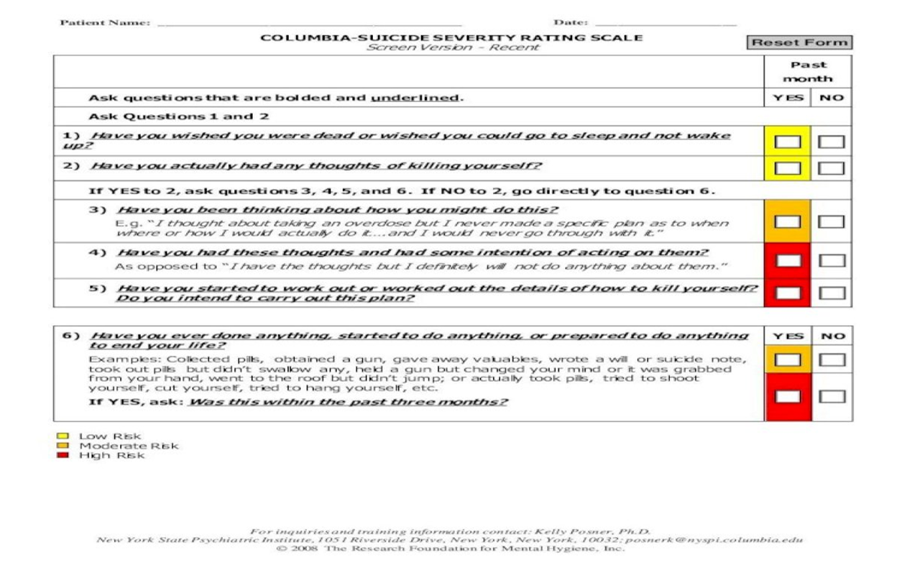
Example Suicide Scale:

Slide 34
Resources to Give to Youth
Franklin County Crisis Services: 413-774-5411
Call or text the Suicide and Crisis Lifeline at 988
Crisis Text Line by texting 4HOPE to 741741
The Trevor Project: Call: 1-866-488-7386 or Text 678-678

Slide 35
Case Example
Jimmy was seen initially in the school social workers office following an explosive loss of temper in the halls at school involving threats of violence and death threats to the people around him. The school resource officer was able to de-escalate the situation and he was able to return home. Witnesses report that the precipitant was his being confronted by several rowdy members of a sport’s team who were teasing him about his style of dress. He is an 18 y/o junior of somewhat slight build who favors dark baggy clothing and wears his hair long and loose. He calms somewhat in the social work office but continues to pace muttering under his breath half heard threats about the boys involved. Jimmy is normally quiet and somewhat withdrawn from social circles. He has come to staff attention over recent weeks due to the violent themes of death incorporated into his writing and art projects. When the SRO searched him after the incident, he was found to be carrying a large sheath knife that he angrily stated was for his own protection. “If you take that, you might as well kill me, because I’m dead meat without it; they’ll kill me for sure now.” When asked to explain himself, Jimmy refused to talk further. He also refused to answer questions about any suicidal or violent ideation. His parents report that he has been increasingly withdrawn over recent weeks and has isolated himself in his room on the computer. They indicated that he barely talks to them and is often heard up and pacing late into the night and seems to be talking to himself at these times.

Slide 36
Questions?
Dana Duval, LICSW
413-834-0740
Dana.Duval@csoinc.org
Kaitlin Richotte-Rock, LMHC
Notes:
I like that little guy but he can probably be deleted…

